Slide 1
WEEK 5 NEURAL NETWORK PROJECT
Movie Review Sentiment Analysis
Classifying real IMDB movie reviews as positive or negative using text tokenization and an ANN in TensorFlow.
Project Topic
Dataset
Tool
Movie Review Sentiment Analysis
Stanford ACL IMDB
TensorFlow/Keras
1

Slide 2
MOVIE REVIEW SENTIMENT ANALYSIS
The project predicts sentiment from real review text.
Goal: train a beginner-friendly neural network that reads movie-review text and predicts whether the review is positive or negative.
4,000
80 / 20
real reviews used
train-test split
Download and load real Stanford ACL IMDB reviews.
Clean the review text and convert words into tokens.
10,000
250
Train an ANN model and evaluate it on unseen test reviews.
vocabulary size
tokens per review
Use the trained model to predict sentiment for new reviews.
2

Slide 3
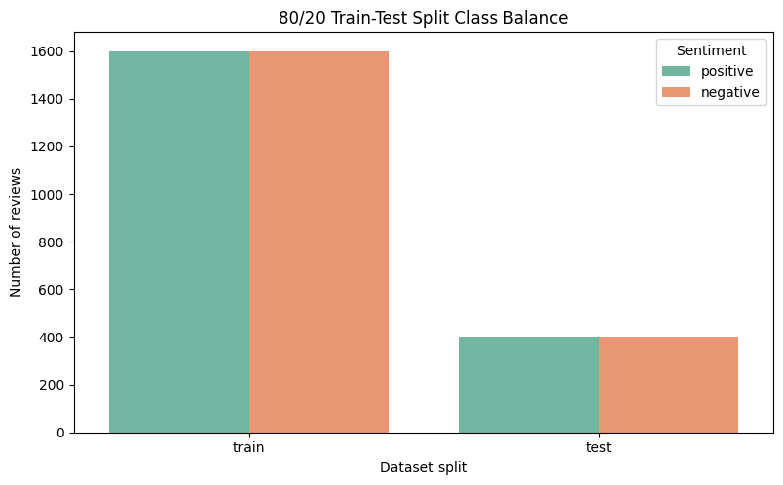
MOVIE REVIEW SENTIMENT ANALYSIS
The real dataset was split into balanced train and test sets.
The notebook combines real ACL IMDB review files and creates a stratified 80/20 split. This keeps positive and negative reviews balanced in both sets.
3,200
800
training reviews
testing reviews
Train: 1,600 positive and 1,600 negative. Test: 400 positive and 400 negative.
3

Slide 4
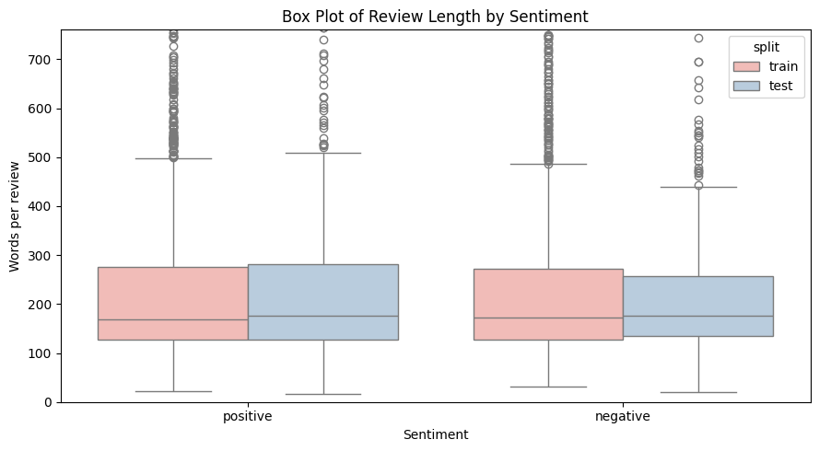
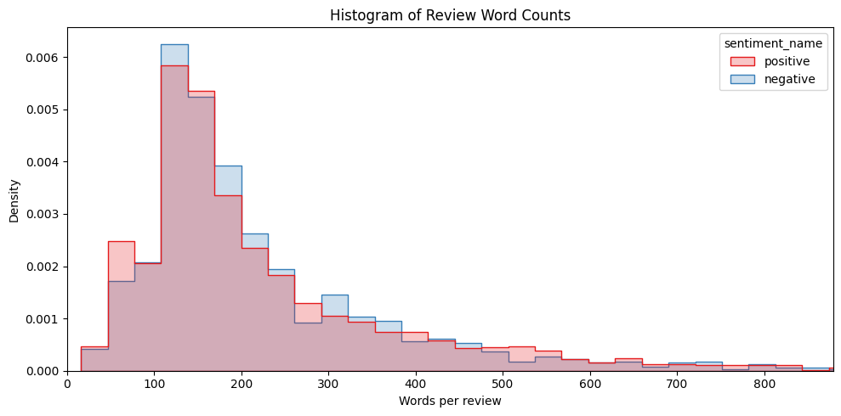
MOVIE REVIEW SENTIMENT ANALYSIS
Review length varies widely, so the input length is fixed.
The histogram and box plot show that most reviews are medium length, while some reviews are much longer. The ANN receives a fixed sequence length of 250 tokens.
4

Slide 5
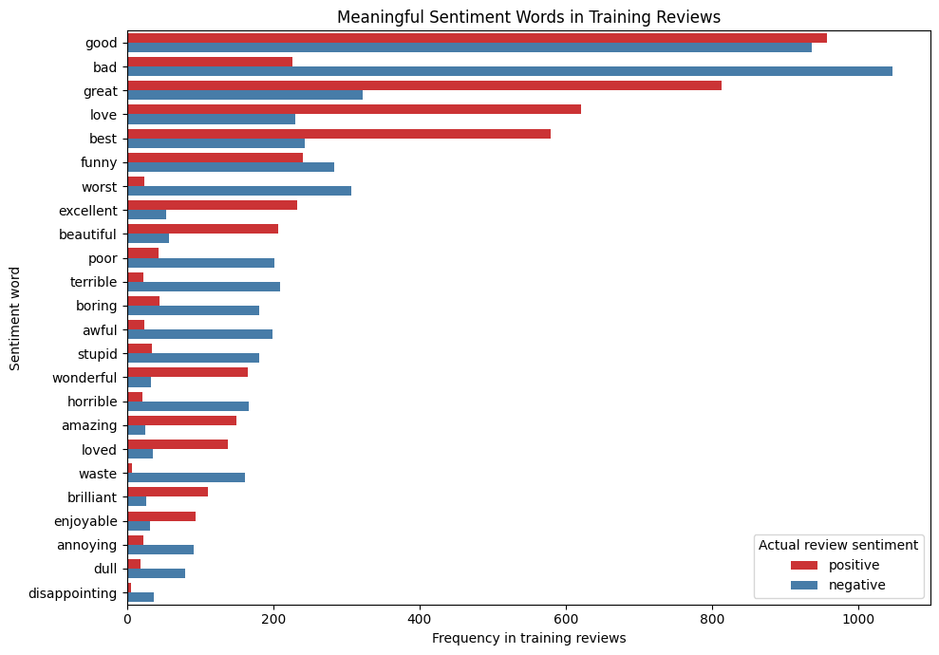
MOVIE REVIEW SENTIMENT ANALYSIS
Meaningful sentiment words show what reviews emphasize.
Instead of counting words like 'the' and 'a', this chart compares useful sentiment terms such as good, excellent, bad, boring, awful, and worst across positive and negative reviews.
5

Slide 6
MOVIE REVIEW SENTIMENT ANALYSIS
Text cleaning and tokenization prepare reviews for the ANN.
The notebook keeps the preprocessing simple and beginner-friendly.
Convert text to lowercase.
TextVectorization
max_tokens = 10000
sequence_length = 250
Input text
-> tokens
-> ANN input
Remove HTML line breaks, punctuation, and extra spaces.
Use TextVectorization to convert words into integer token IDs.
Pad or trim every review to 250 tokens.
6

Slide 7
MOVIE REVIEW SENTIMENT ANALYSIS
The ANN learns patterns from tokenized review text.
The model architecture used in the notebook is shown as the actual layer order.
Input(shape=(), dtype=tf.string)
TextVectorization
Embedding(10000, 64)
GlobalAveragePooling1D
Dense(64, relu)
Dropout(0.5)
Dense(32, relu)
Dropout(0.3)
Dense(1, sigmoid)
Embedding learns word representations.
Pooling converts token vectors into one review vector.
Dense and dropout layers learn sentiment patterns.
Sigmoid outputs a positive probability from 0 to 1.
7

Slide 8
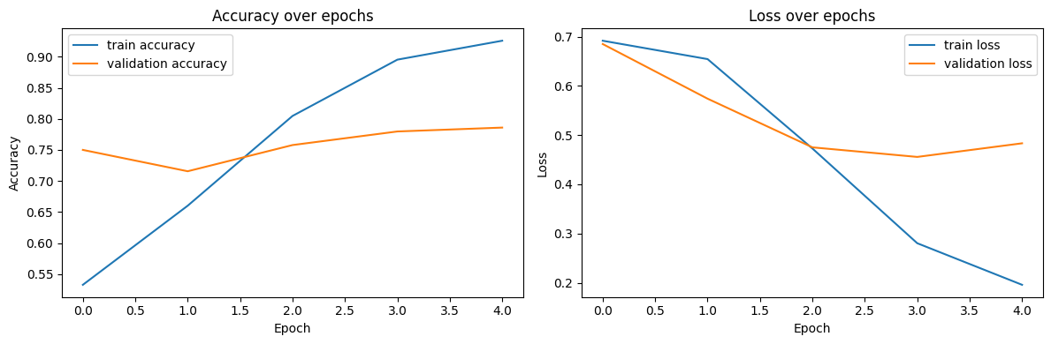
MOVIE REVIEW SENTIMENT ANALYSIS
Training improved accuracy while reducing loss.
The model trained for 5 epochs with Adam, binary crossentropy, batch size 32, and EarlyStopping.
8

Slide 9
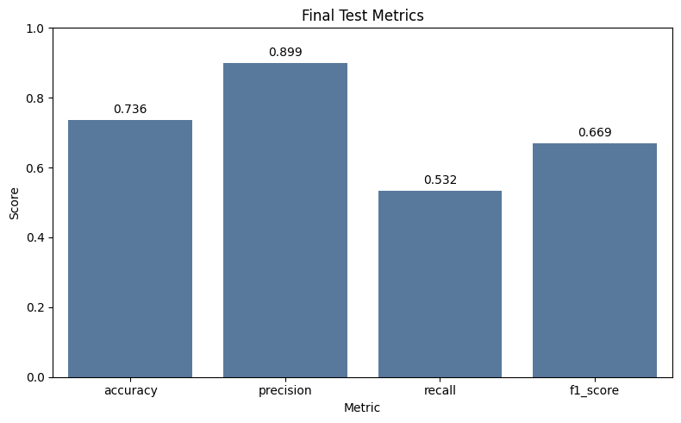
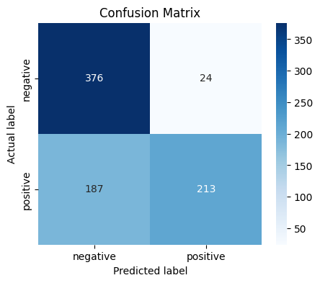
MOVIE REVIEW SENTIMENT ANALYSIS
Final test results show a useful baseline model.
The model reached 73.6% accuracy on 800 unseen test reviews. It was careful when predicting positive reviews, but it missed some actual positives.
Accuracy 0.736 | Precision 0.899 | Recall 0.533 | F1 0.669
9

Slide 10
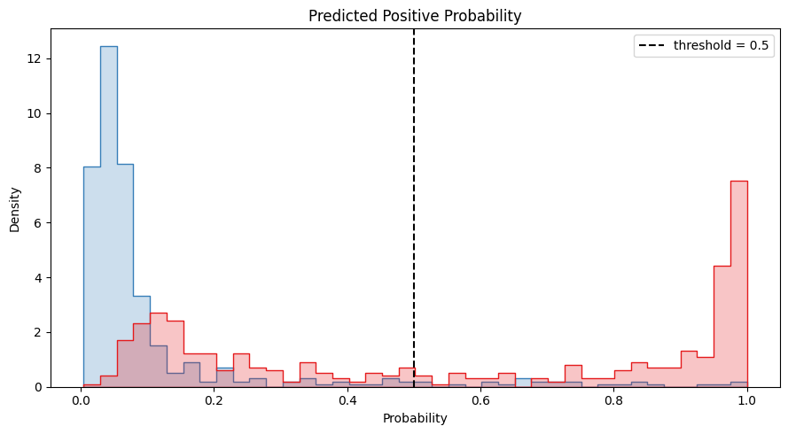
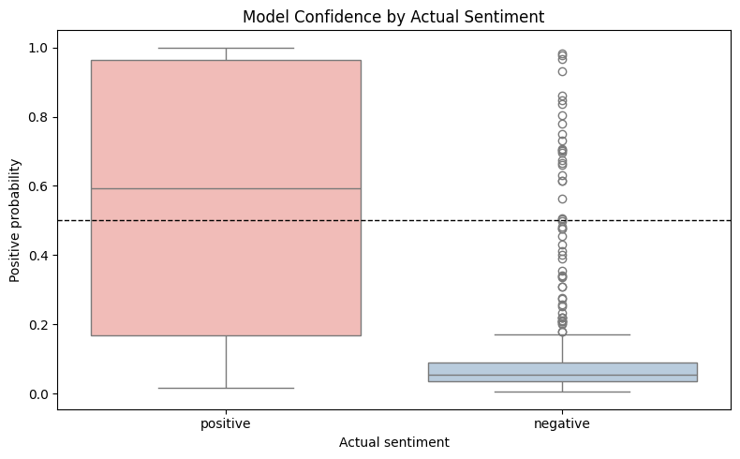
MOVIE REVIEW SENTIMENT ANALYSIS
Prediction scores show how confident the model is.
The prediction plots show the probability score produced by the trained ANN. A score near 1 means the model leans positive; a score near 0 means it leans negative.
10

Slide 11
MOVIE REVIEW SENTIMENT ANALYSIS
The prediction function returns a probability and a label.
After training, the notebook can send any review through the same cleaning, tokenization, and ANN model.
Example
Positive probability
Prediction
The project uses real data, not a fake dataset.
Positive test review
0.991
positive
The PPT now shows actual notebook visuals and model results.
Next improvement: train on more data and tune the 0.5 threshold.
11

Slide 12
MOVIE REVIEW SENTIMENT ANALYSIS
The project builds a complete sentiment-analysis pipeline.
This project starts with real IMDB review text, prepares it for a neural network, trains an ANN model, evaluates the results, and uses the trained model for prediction.
0.736
0.899
0.669
Conclusion
test accuracy
precision
F1 score
The ANN gives a working baseline for positive and negative review classification. The results are useful, and performance can improve further by training on more reviews and testing stronger text models.
Future scope: full dataset training, better threshold tuning, LSTM/GRU/CNN comparison, or a simple web app.
12

